Slide 1

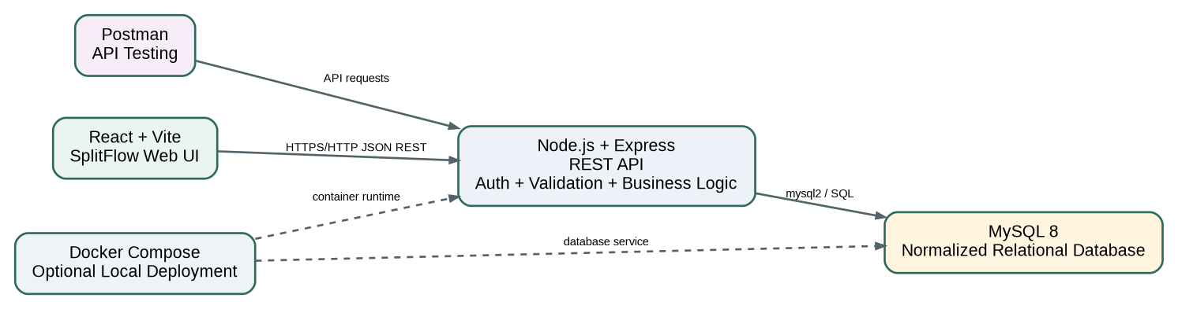
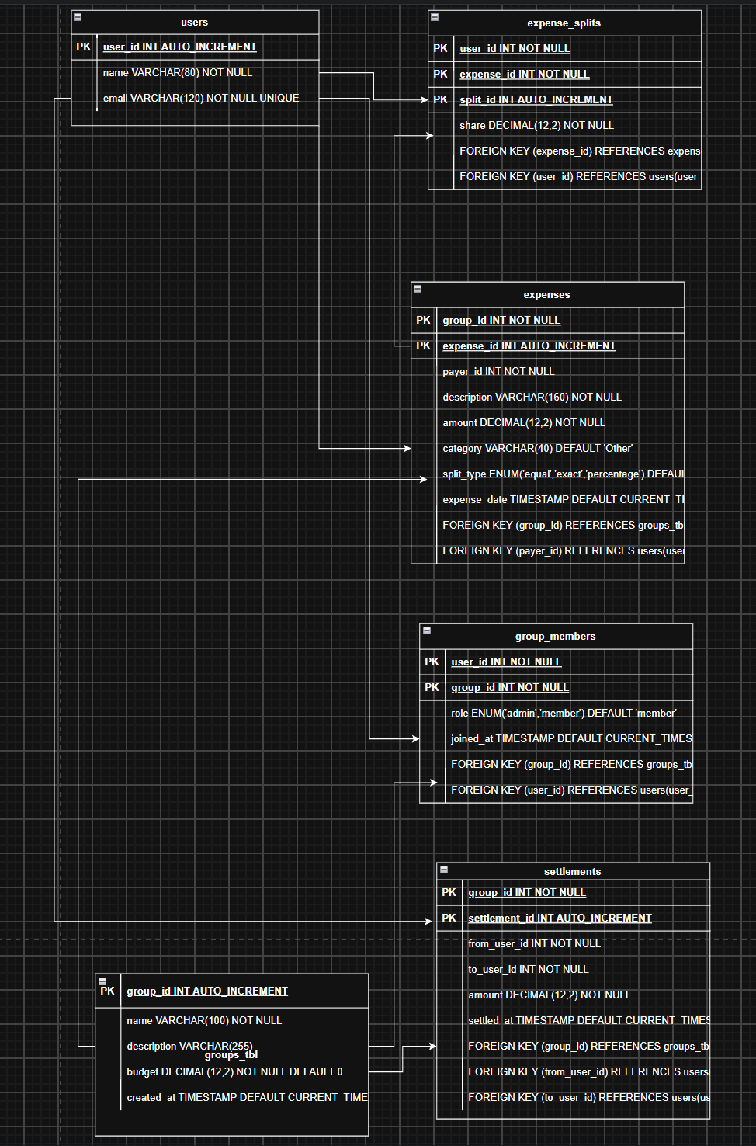
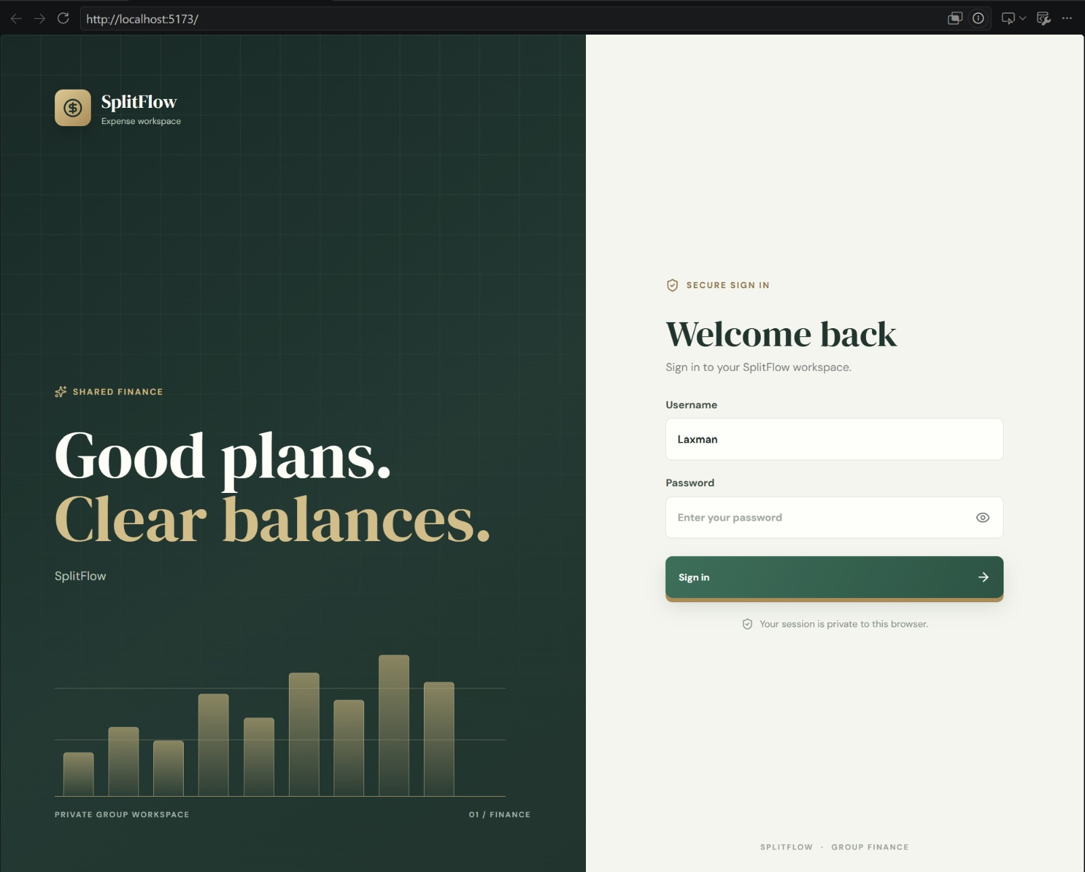
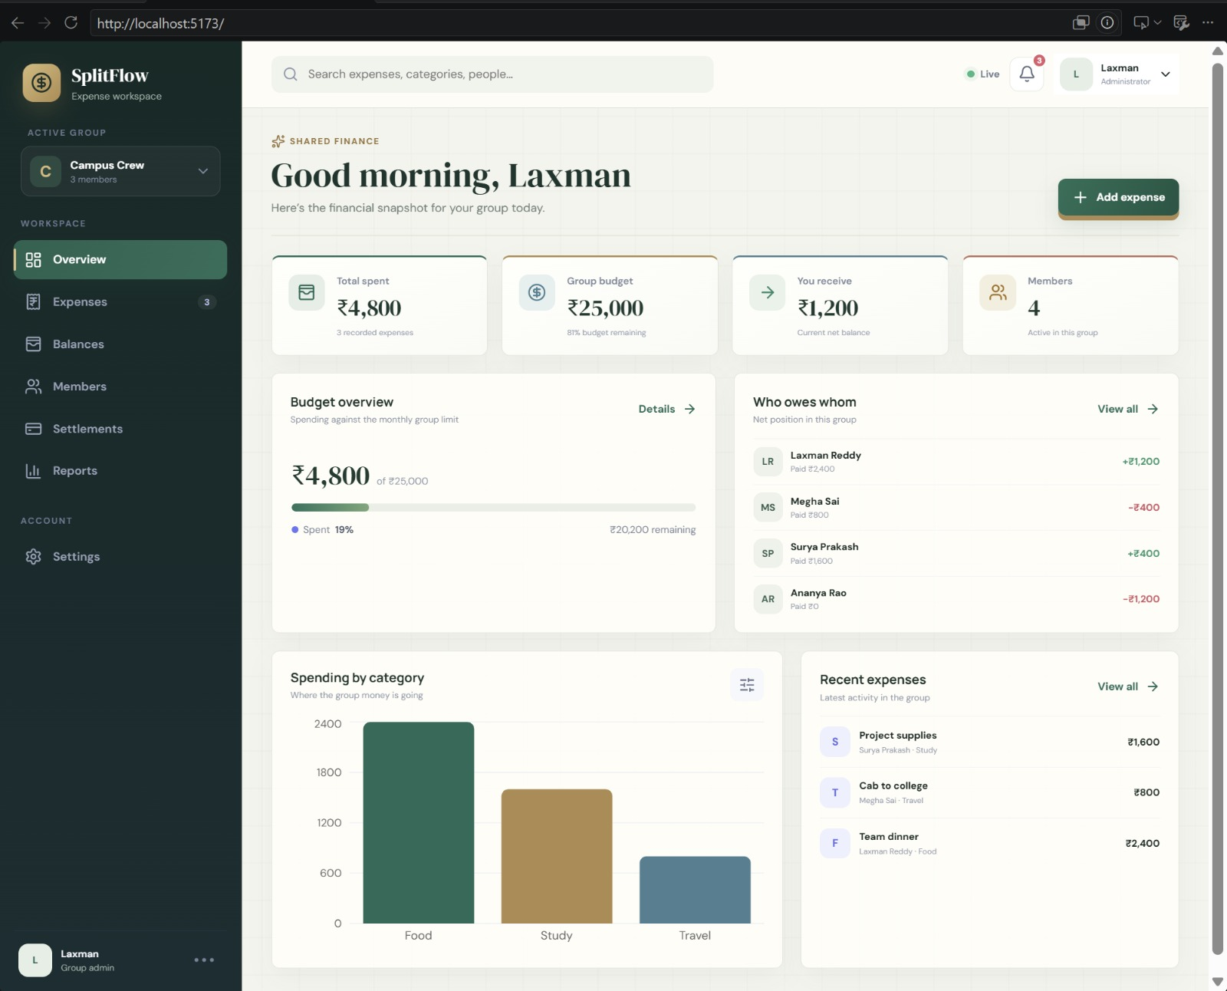

EXPENSE SPLITTER & GROUP BUDGET MANAGER
Team ID: 8 | Section: S_9_ | Members: Laxman Reddy – 2520030097, Meghanadhi Sai – 2520030274, Surya Prakash Reddy – 2520030145 | Guide: Dr. Y Prasanthi
Database Systems Engineering and Distributed Backend Development (25CS1302E) | KLH Bachupally Campus, CSE | PBL 2026–27
Abstract
Tools & Technologies
Centralized web application for shared expenses among friends, roommates, families and project teams. Users create groups, add members, record expenses, select equal/exact/percentage splits, monitor budgets, view balances and record settlements. React + Vite, Node.js + Express and MySQL 8 provide the implementation.
• Front-End: React 19 + Vite + Lucide + Recharts
• Back-End: Node.js + Express 5 + REST APIs
• Database: MySQL 8 + mysql2
• Testing: Postman
• Optional deployment: Docker Compose
Problem Statement & Objectives
System Architecture
Problem: Different contributions, manual calculations, unclear balances and difficult budget tracking make shared expenses hard to manage.
Objectives:
• Centralize expenses and groups
• Support flexible splitting
• Calculate balances automatically
• Monitor budgets
• Simplify settlement
Existing vs Proposed System
Feature | Existing | Proposed
Records | Separate/manual | Centralized ledger
Splitting | Manual arithmetic | Equal / exact / %
Balances | Unclear | Automatic calculation
Budget | Separate tracking | Integrated monitoring
Settlement | Manual | Recorded payments
ER Diagram & Database Design
Feasibility Study
• Technical: React, Express, MySQL, REST, SQL, Postman and Docker are available.
• Economic: open-source development stack; local setup uses free tools.
• Operational: dashboard centralizes common group-finance tasks.
• Schedule: modular architecture supports semester project delivery.
Results & Testing
Conclusion
Implementation Screenshots
• Demo group: Campus Crew (4 members)
• Budget: ₹25,000
• Total spent: ₹4,800
• Remaining: ₹20,200
• Balance calculations validated
• REST API and DB transaction flows tested
Centralizes expenses, budgets, balances and settlements while reducing repeated manual calculations.
Future Scope
• Payment gateway and email integration
• Scalable cloud deployment
• Service-oriented / microservice evolution
• Enhanced budgeting, notifications and settlement automation
References: [1] Project database/schema.sql [2] React / Express / MySQL documentation [3] Postman collection included in project
GitHub

